Slide 1
Lighting and Shading
Computer Graphics

Slide 2
Reading
Hearn & Baker, Chapter 10
Angel, Chapter 6
Watt, Chapter 6

Slide 3
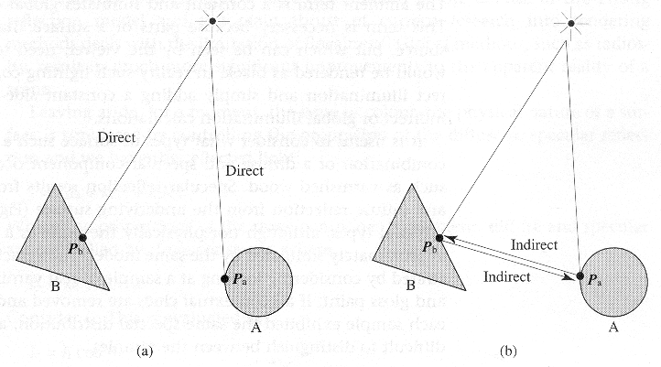
Local and Global Reflection Models
Local reflection
Global reflection

Slide 4
Three Reflection Phenomena
Perfect specular reflection
Mirror
Imperfect specular reflection
Rough surface (collection of tiny mirrors, different orientations)
Perfect diffuse reflection
Reflects the light equally in all directions
Matte (non-glossy): perfect diffuse surface

Slide 5
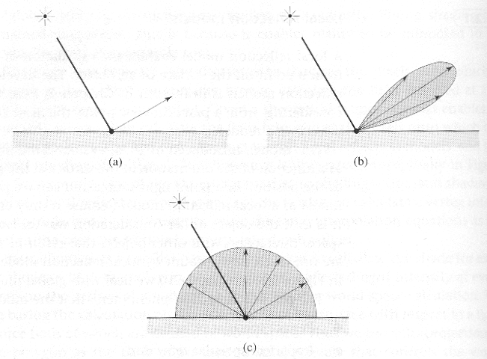
Three Reflection Phenomena
Perfect specular
Imperfect specular
Perfect diffuse

Slide 6
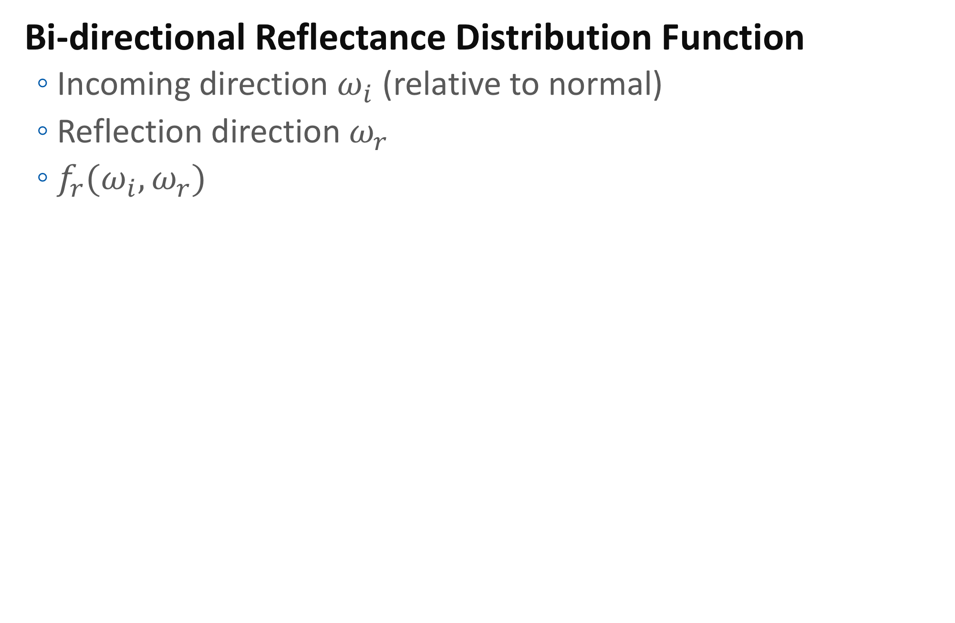
BRDF
Bi-directional Reflectance Distribution Function
Incoming direction $ω_{i}$ (relative to normal)
Reflection direction $ω_{r}$
$f_{r}(ω_{i},ω_{r})$

Slide 7
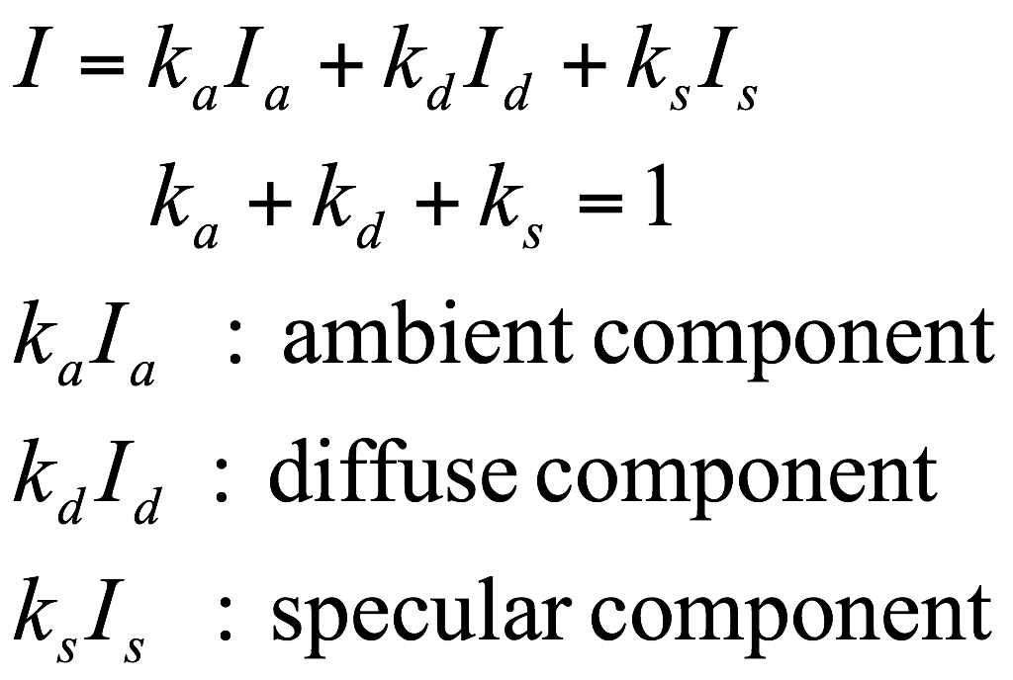
Phong Reflection Model - 1
Heavily simplified analytic BRDF
Reflected light
Ambient light
Constant and global light
Approximating indirect lights with one simple constant
Making scene very unrealistic

Slide 8
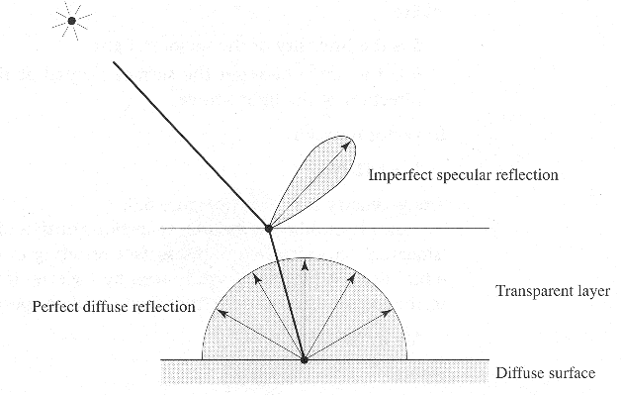
Phong Reflection Model - 2
The “Computer Graphics” surface model

Slide 9
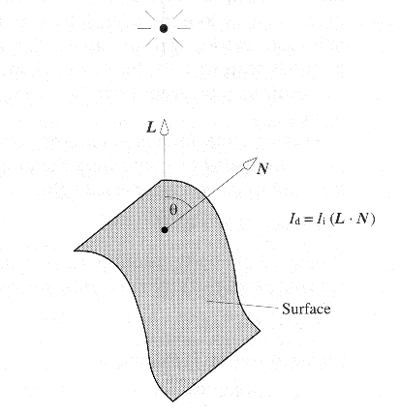
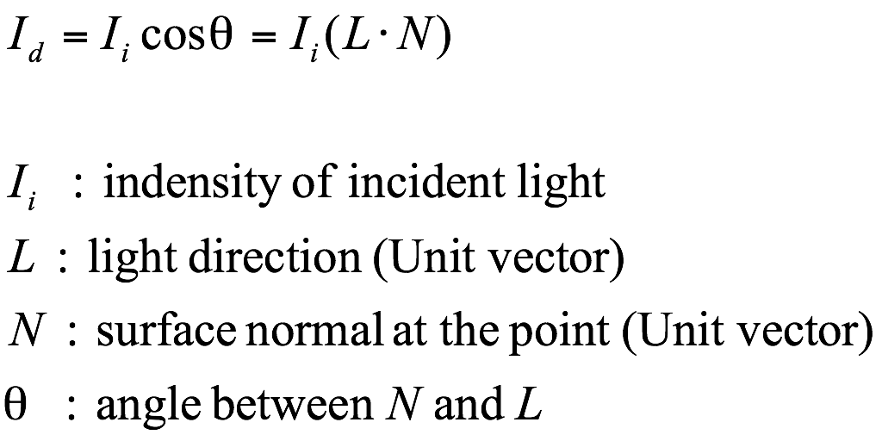
Phong Reflection Model - 3
Diffuse reflection (Lambertian)

Slide 10
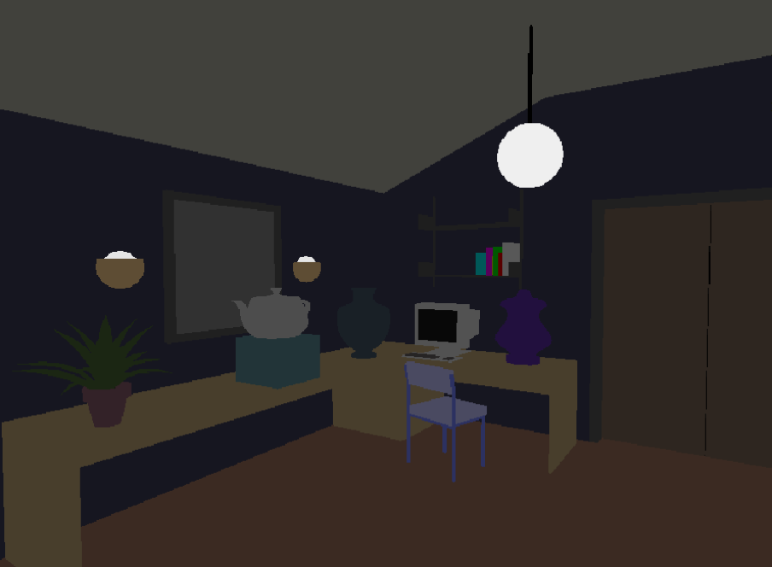
Phong Reflection Model - 4
Ambient compoent only

Slide 11
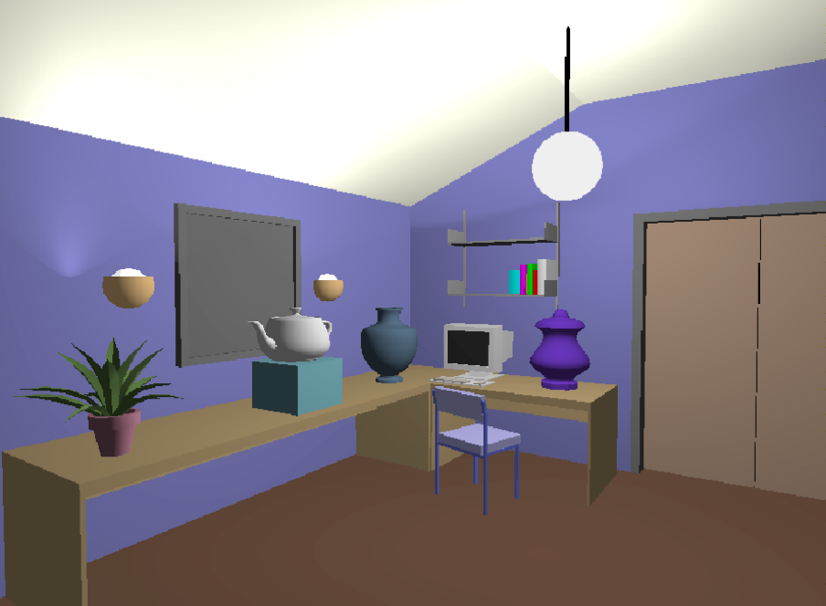
Phong Reflection Model - 5
Ambient + Diffuse

Slide 12
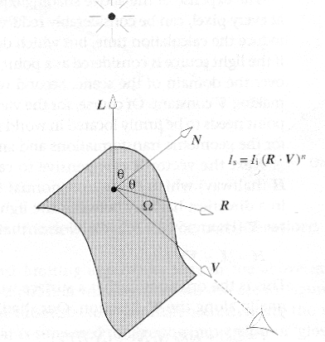
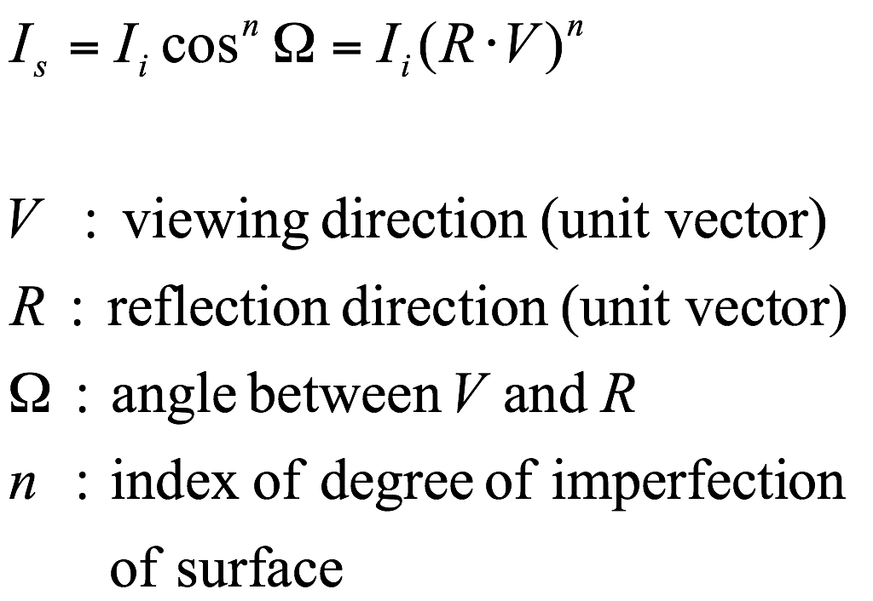
Phong Reflection Model - 6
Specular component

Slide 13
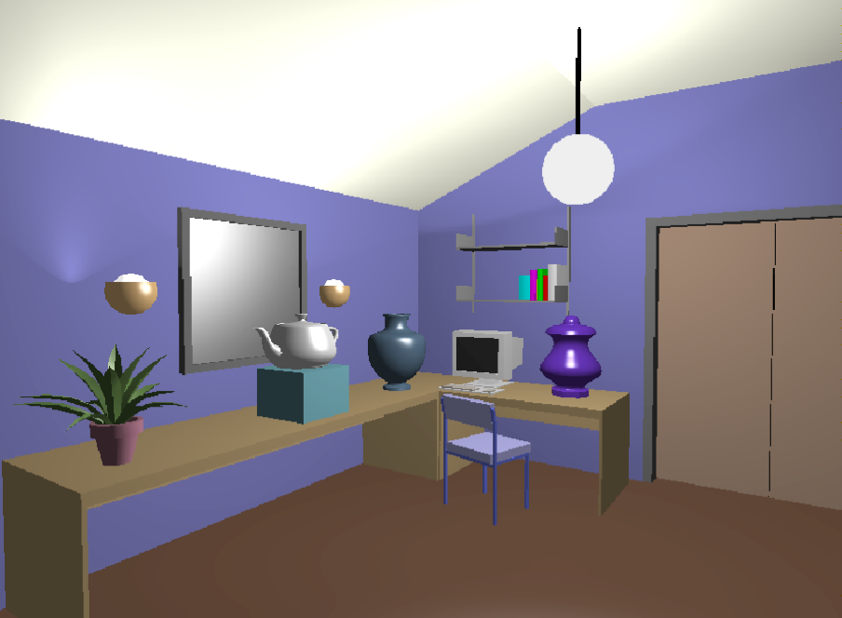
Phong Reflection Model - 7
Ambient + Diffuse + Specular

Slide 14
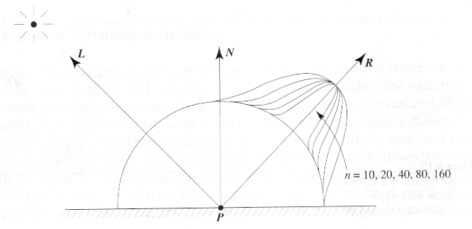
Phong Reflection Model - 8
The light intensity at point P as a function of the orientation of the viewing vector V
n is called “shininess”.

Slide 15
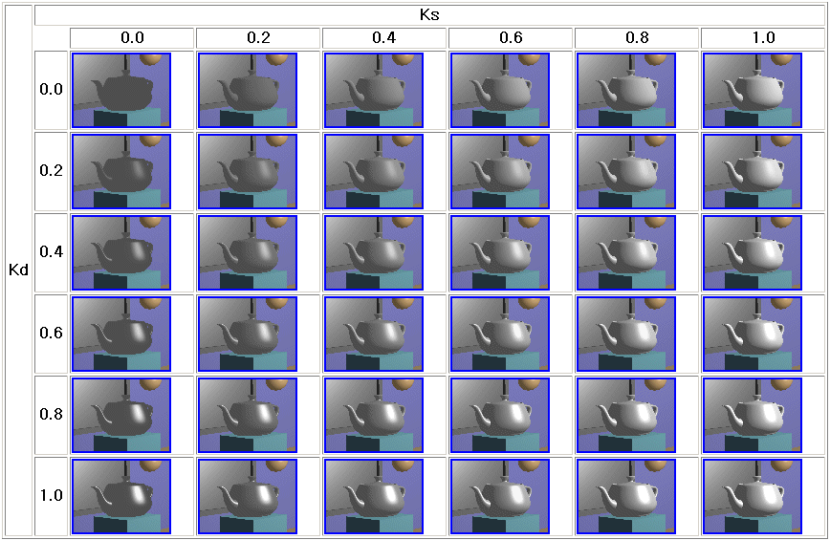
Phong Reflection Model - 9

Slide 16
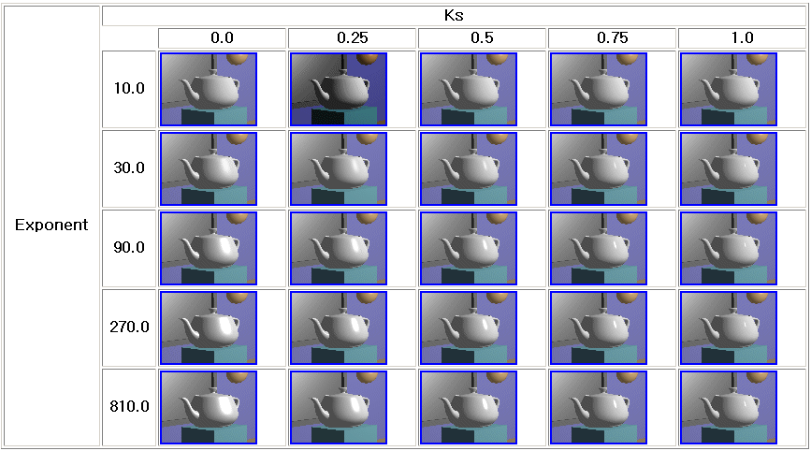
Phong Reflection Model - 10

Slide 17
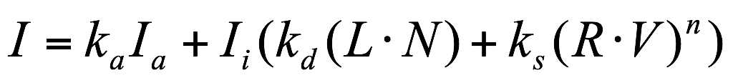
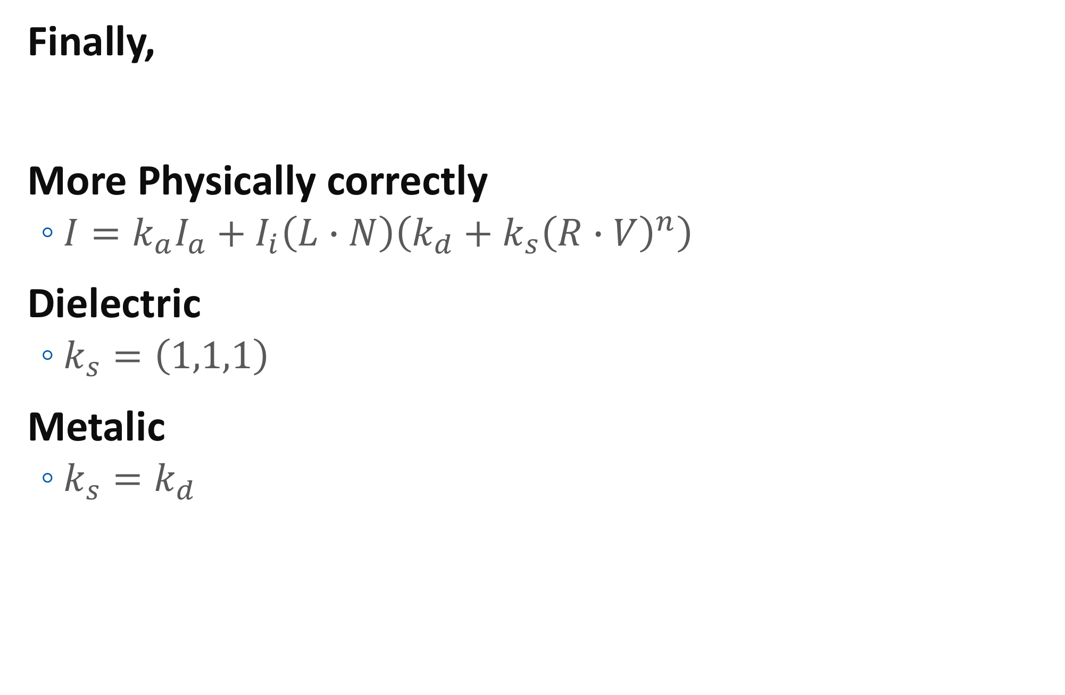
Phong Reflection Model - 11
Finally,
More Physically correctly
$I=k_{a}I_{a}+I_{i}\left(L∙N\right)\left(k_{d}+k_{s}{\left(R∙V\right)}^{n}\right)$
Dielectric
$k_{s}=\left(1,1,1\right)$
Metalic
$k_{s}=k_{d}$

Slide 18
Point Light vs Directional Light
Point light
L is dependent to the vertex position
Incident light intensity is inversely proportional to squared distance
Directional light
L is constant
L
L
L

Slide 19



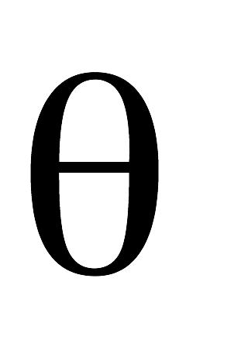
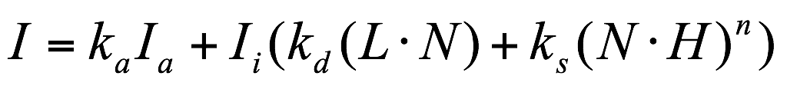

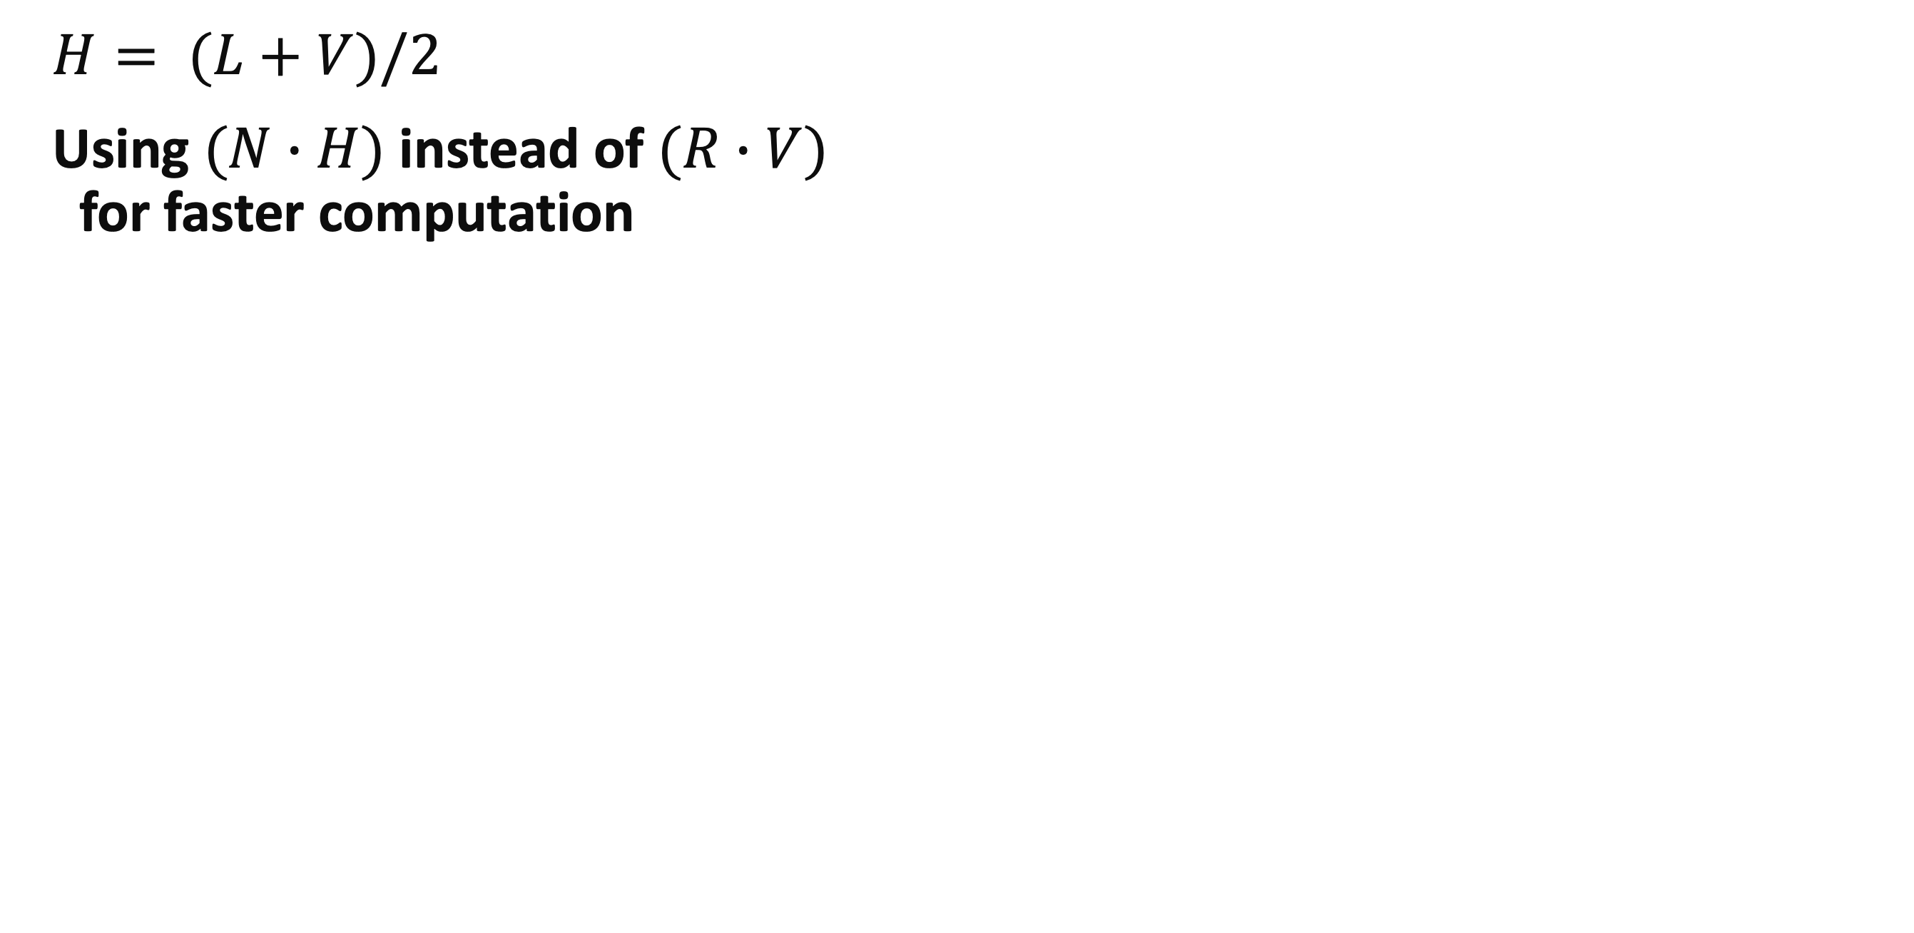
Blinn-Phong Model
$H= (L+V)/2$
Using $(N∙H)$ instead of $(R∙V)$ for faster computation

Slide 20
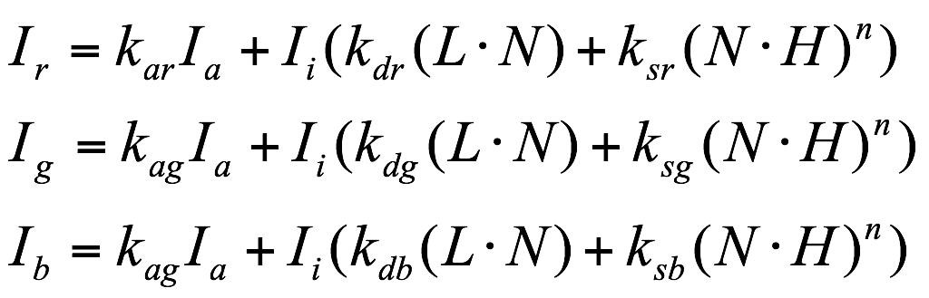
Reflection Model - Components
R, G, B components
Or in vector equation
$$I=k_{d}I_{a}+I_{i}\left(k_{d}\left(L∙N\right)+k_{s}{\left(N∙H\right)}^{n}\right)$$

Slide 21
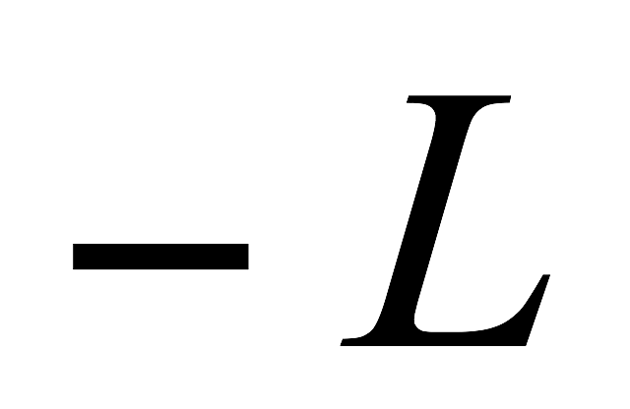
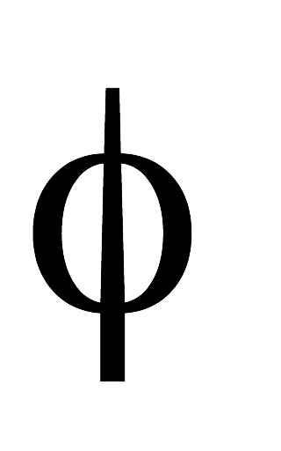
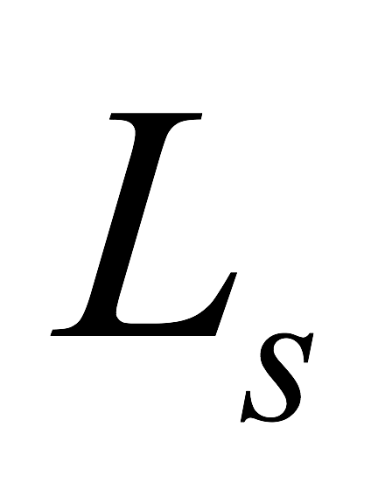
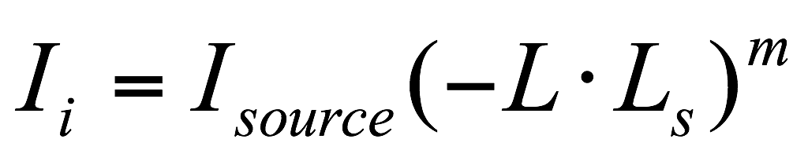
Warn’s Light Source Rep.
Spotlight
The light emitted from the source is given by a cosine function raised to a power.

Slide 22
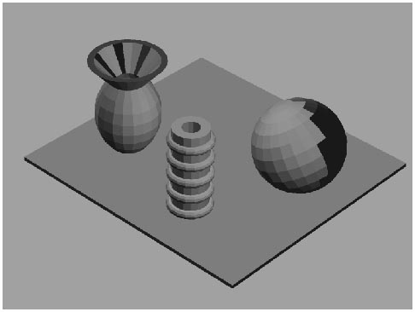
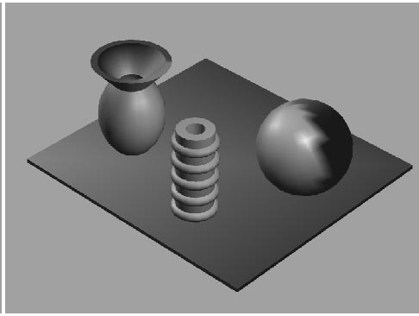
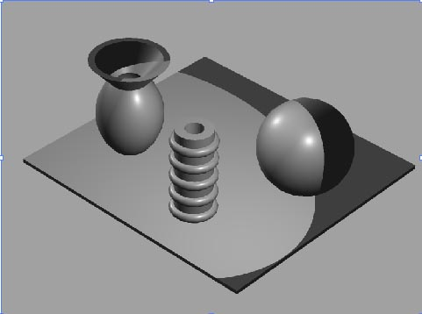
What’s lighting and what’s shading?
Lighting: the interaction between light and matter
Shading: do lighting (at vertices) and determine pixel’s colors from these
Three types of shading:
Flat, Gouraud, and Phong
Tomas Akenine-Mőller © 2002
Notes:
Here, we need to distinguish lighting from shading.
Lighting is the term that is used to indicate the interaction between material and light sources and their interactions with the geometry of the rendered object.
Also, lighting can be used with colors, textures, and transparency.
On the other hand, shading is the process of performing lighting computations and determining pixels’ colors from them.
There are three main types of shading: flat, Gouraud, and Phong.
These corresponds to computing the light per polygon, per vertex, and per pixel.
These figures shows their examples.
As you know, flat shading runs fast and is simple to implement.
But like this figure, the flat shading does not provide a smooth look to curved surfaces.
When the user wants to see the underlying facets, the flat shading can be an advantage.
Most graphics hardware implement Gouraud shading because this is fast and give much improved quality.
However, this shading cannot include highlights and spotlight effects.
We can overcome these problems in Phong shading.
This interpolate the surface normal and compute the lighting at each pixel. But this costs much more than per-vertex lighting.

Slide 23
Interpolative Shading Technique
To calculate the light intensity over the surface of a polygon by interpolation.
Compute lighting per vertex
Gouraud shading
Compute lighting at each vertex and interpolate
Compute lighting per fragment
Phong shading
Interpolate normal vector and compute lighting at each fragment

Slide 24
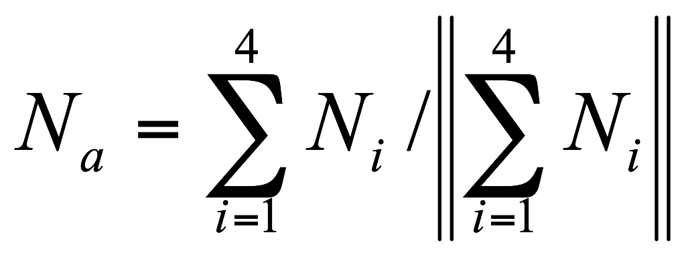
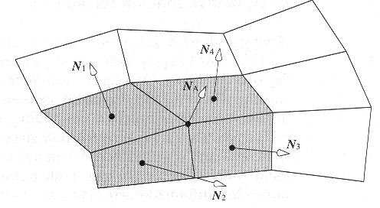
Gouraud Shading - 1
Use the vertex normal
Compute the light intensity at each vertex.
Intensities at interior points are obtained by interpolation.

Slide 25
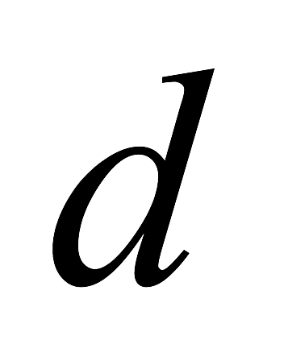
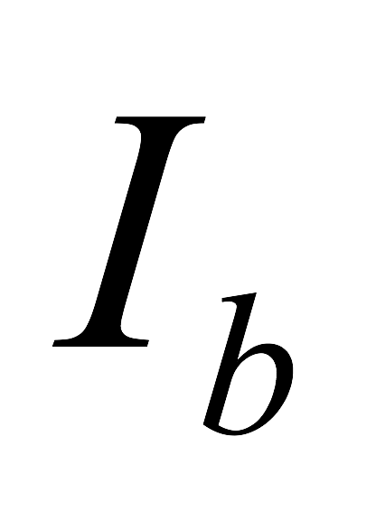
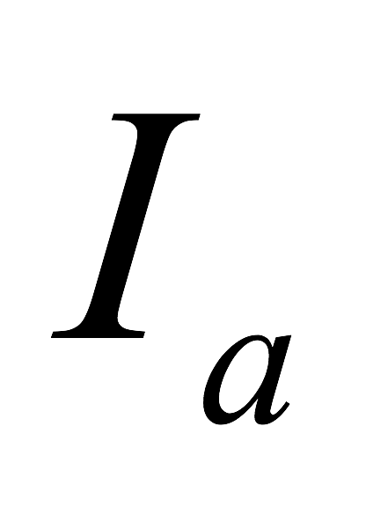

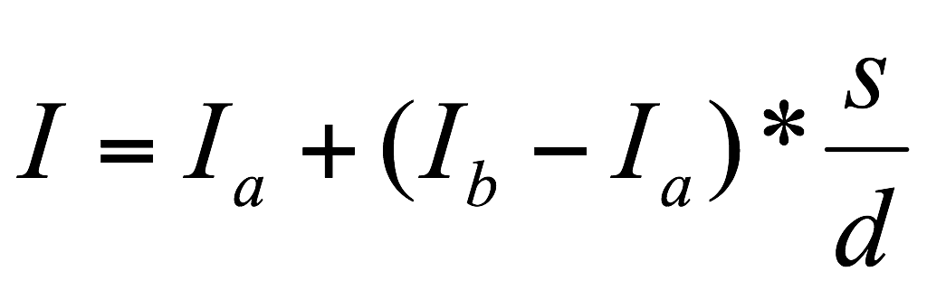
Gouraud Shading - 2
Intensity Interpolation (bilinear interpolation)

Slide 26
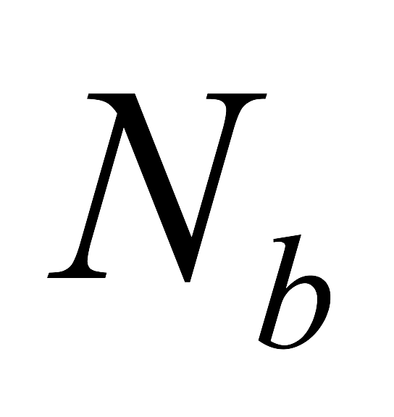
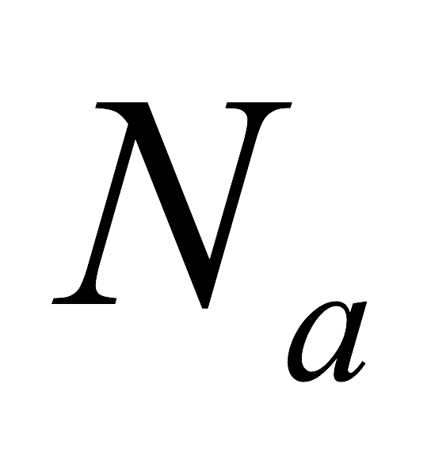
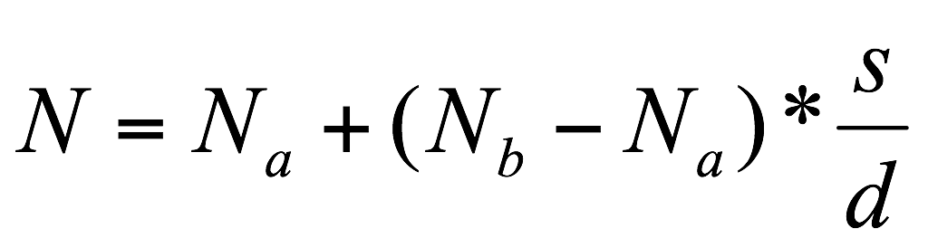
Phong Shading
Compute pixel intensity with the interpolated normal at each pixel

Slide 27
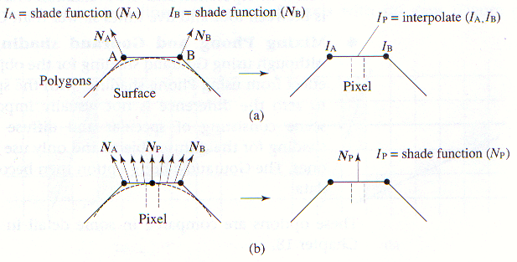
Gouraud v.s. Phong Shading

Slide 28
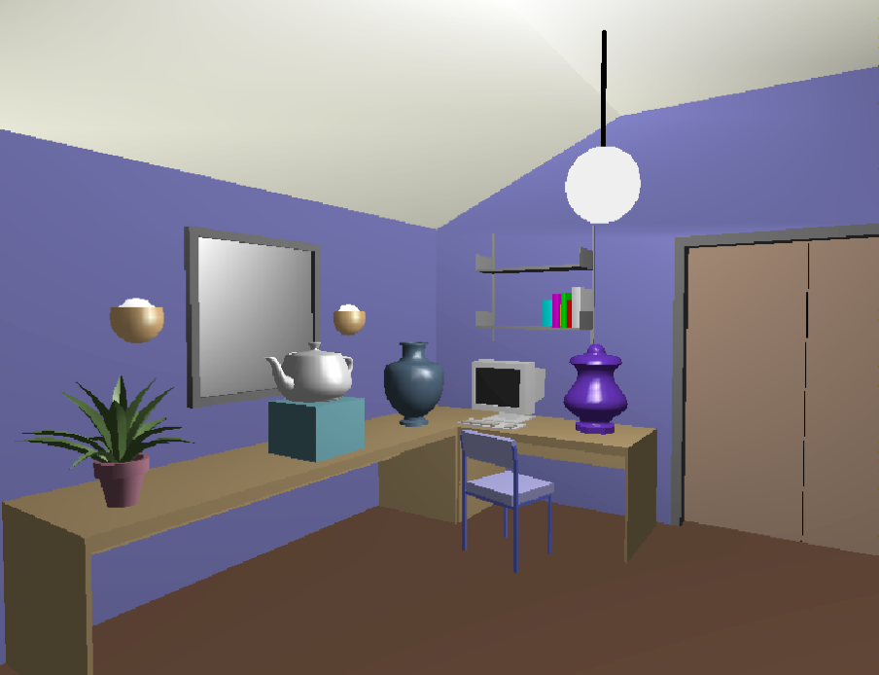
Gouraud Shading Example

Slide 29
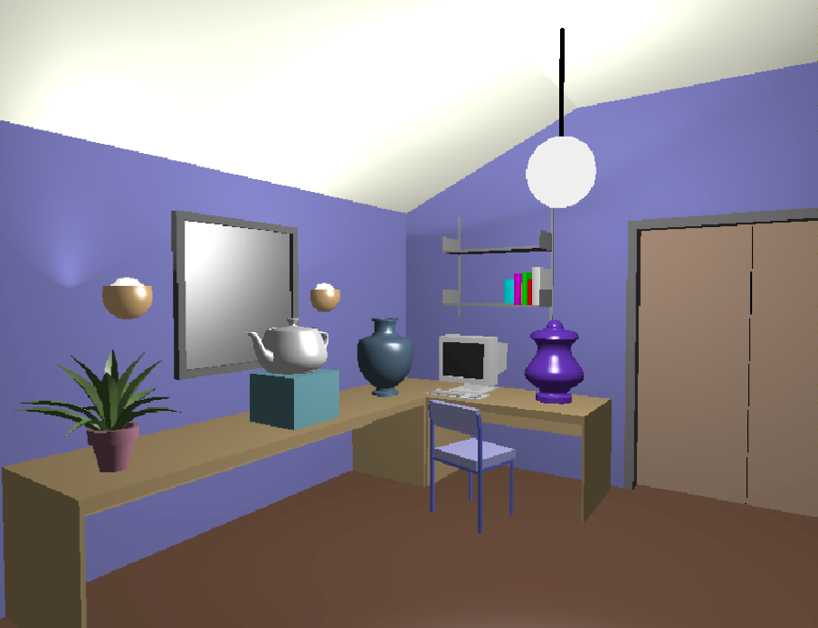
Phong Shading Example

Slide 30
Gouraud v.s. Phong Shading

Slide 31
Renderer Shading Options
Wireframe
Flat Shaded Polygons (Flat Shading)
Gouraud Shading
Phong Shading
Mixing Phong and Gouraud Shading
Diffuse objects : Gouraud
Diffuse + Specular objects: Phong

Slide 32
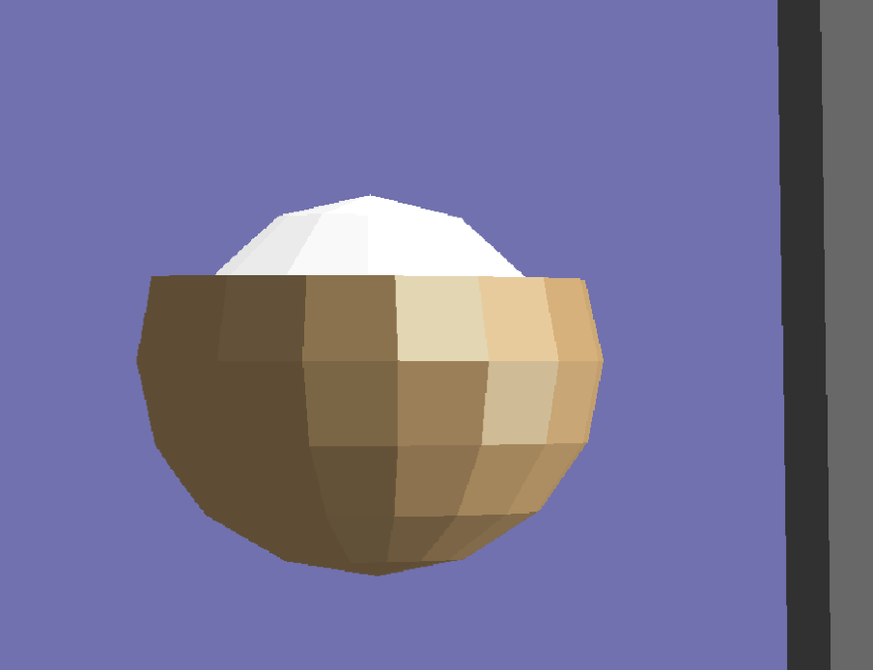
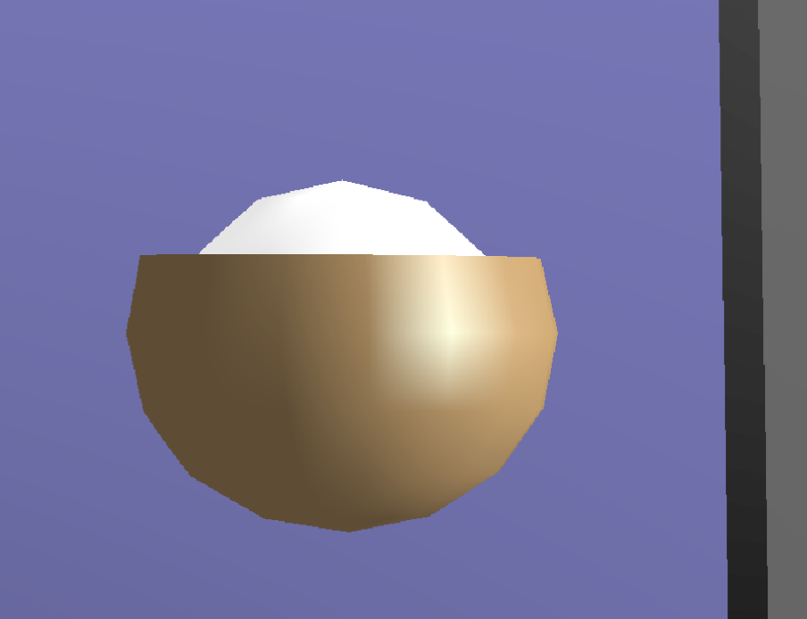
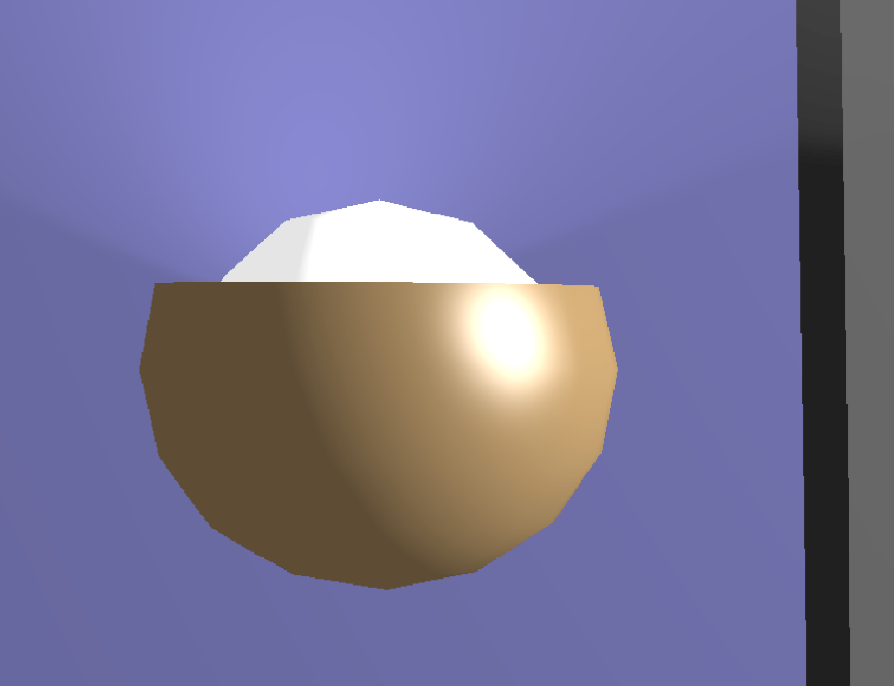
Renderer Shading Option Example

Slide 33
Basic OpenGL Phong Shading
Vertex shader
Needs normal vector as a vertex attribute
Steps
Create a array buffer for normal vectors
Fill the buffer with data
Attach the buffer to the vertex array
Transform normal vector
Compute the transformed normal vector based on the model transformation
Send it to the fragment shader

Slide 34
Basic OpenGL Phong Shading
A few uniform variables are required
Diffuse color
Specular color
Ambient color?
Shininess
Light position (or L for directional light)
Light color (intensity)
Camera position

Slide 35
Basic Phong Shading
Directional Light
vec3 I_diff = colorDiff.rgb * clamp( dot ( N, L ), 0, 1) * lightColor;
// N is normal vector
// L is light direction (to light)
vec3 I_spec = colorSpec * pow( clamp(dot ( R, V ),0,1), shininess) * clamp( dot ( N, L ), 0, 1) * lightColor;
// R is reflection vector
// V is view vector (object to camera)
How we compute all the values?
N, L, R, and V

Slide 36
Basic Phong Shading
In Vertex Shader
out vec3 normal; // normal vector
out vec3 worldPos; // world coordinate of the point
In Fragment Shader
in vec3 normal;
in vec3 worldPos;
uniform vec3 cameraPos; // Camera position in wc
uniform vec3 lightPos; // The position of light in wc

Slide 37
Basic Phong Shading
Computing per fragment data
vec3 N = normalize( normal ); // This is the key of Phong shading
vec3 toLight = lightPos - worldPos; // vector to light
vec3 L = normalize( toLight ); // light direction
vec3 V = normalize( cameraPos - worldPos ); // to camera
vec3 R = N*(dot(L,N))*2 - L;
// R + L = N * (dot( L, N ) )*2
vec3 I = // compute diffuse
I+= // compute specular
I+= // add ambient color as required.
out_Color = vec4( I, diffColor.a );

Slide 38
A Few Notes
Light intensity decrease with the distance
vec3 lightInt = lightColor / dot( toLight, toLight );
Color from the file
diffuse color, specular color, and shininess are in
diffuseColor[0], specularColor[0], and shininess[0]

Slide 39
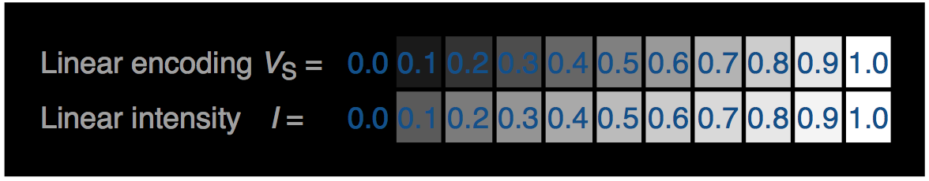
sRGB vs Linear
Color Response of Display
0 is black
1 is white
0.5? (https://en.wikipedia.org/wiki/SRGB)
Display
Traditional CRT
Non-linear response (voltage vs Luma)
The standard for “non-linear” response is called “sRGB”

Slide 40
sRGB vs Linear
Compute system simulates CRT display
The color value are treated as “Voltage”, not “intensity”
The most of image files are written as voltage (more precisely sRGB) not RGB (or linear RGB)
However
We compute “Intensity” not “Voltage”

Slide 41
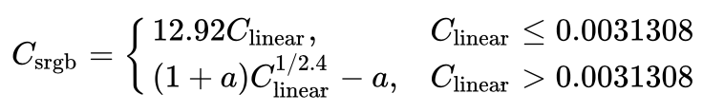
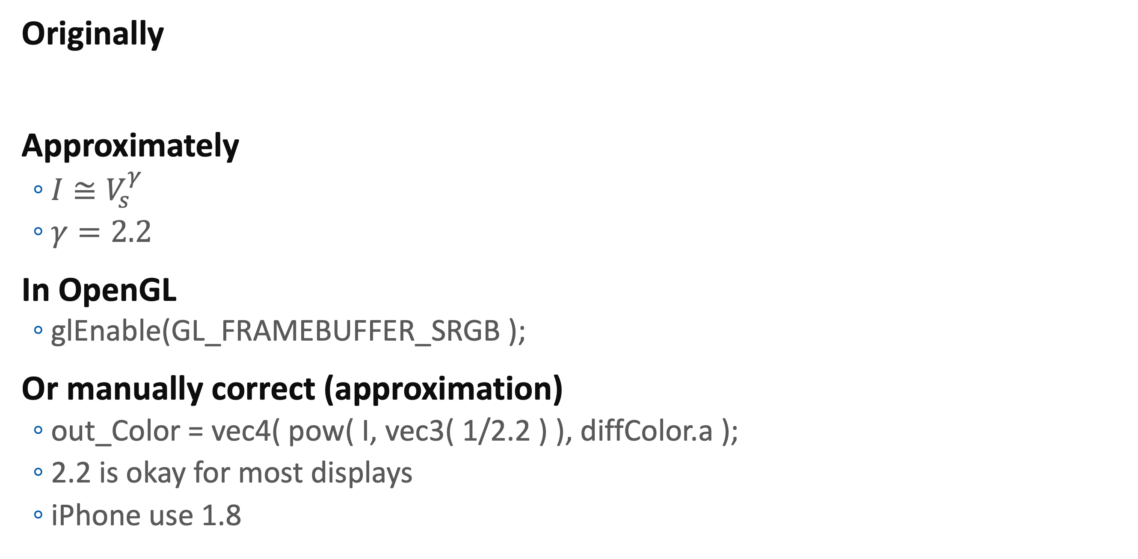
Gamma Correction
Originally
Approximately
$I≅V_{s}^{γ}$
$γ=2.2$
In OpenGL
glEnable(GL_FRAMEBUFFER_SRGB );
Or manually correct (approximation)
out_Color = vec4( pow( I, vec3( 1/2.2 ) ), diffColor.a );
2.2 is okay for most displays
iPhone use 1.8

Slide 42
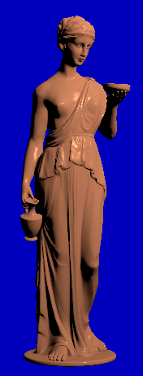
Assignment #4
Implement Phong Shading
Use any model (Hebe is recommended)
Modify main file such that
Enable depth test
Add normal vectors as a vertex attribute
Set uniform variables (camera position, light position, light color, diffuse color, specular color, and shininess)
Vertex shader
Compute world position and world normal
Send them to the fragment shader
Fragment shader
Compute L, N, V, R vectors
Using Phong shading model, compute color of a fragment
Optional: correct gamma

Slide 43
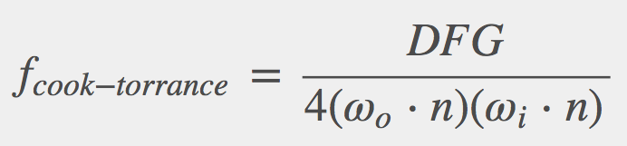
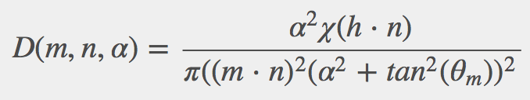
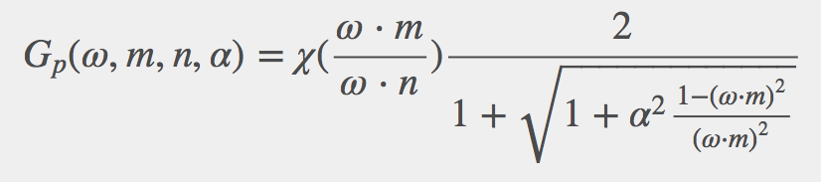
More sophisticated BRDF
Cook-Torrance model
Microfacet model

Slide 44
More sophisticated BRDF
Ward model
Anisotropic distribution
Lighting is dependent to azimuthal direction

Slide 45
More sophisticated BRDF
Oren-Nayar reflection model
Microfacet-based diffuse model

Slide 46
Fresnel Reflectivity
Reflectance increased
when gazing angle decreased
Fresnel reflectivity
For metallic object, all reflection is affected by Fresnel reflectivity
Note that not all surface is perfectly smooth.
For non-metal (dielectric) material, specular light is affect by Fresnel reflectivity

Slide 47
Questions?

